Slide 1

Xatolar

Slide 2
Xato nima?
Nimadir buzilib qolishi… masalan:
MySQLga bog'lana olmaslik (mysqli_connect)
Fayl yoki direktoriya mavjud emas (fopen)
Koddagi xatolar
Mavjud bo'lmagan o'zgaruvchilarga murojaat
; belgisini tushirib qoldirish
Mantiqiy xatolar

Slide 3
Xatolar turlari
E_ERROR
E_WARNING
E_NOTICE
E_PARSE
Boshqalar (E_STRICT, E_DEPRECATED)
Foydalanuvchi xatolari (E_USER_ERROR)

Slide 4
E_ERROR
<?php
funksiya();
Fatal error: Uncaught Error: Call to undefined function funksiya() in D:\C\OpenServer\domains\dars.loc\test.php:2 Stack trace: #0 {main} thrown in D:\C\OpenServer\domains\dars.loc\test.php on line 2

Slide 5
E_WARNING
<?php
fopen('asd.txt', 'r');
Warning: fopen(asd.txt): failed to open stream: No such file or directory in D:\C\OpenServer\domains\dars.loc\test.php on line 2

Slide 6
E_NOTICE
<?php
error_reporting(E_ALL);
$a = $b;
Notice: Undefined variable: b in D:\C\OpenServer\domains\dars.loc\test.php on line 3

Slide 7
E_PARSE
<?php
//error_reporting(E_ALL);
x c
Parse error: syntax error, unexpected 'c' (T_STRING) in D:\C\OpenServer\domains\dars.loc\test.php on line 3

Slide 8
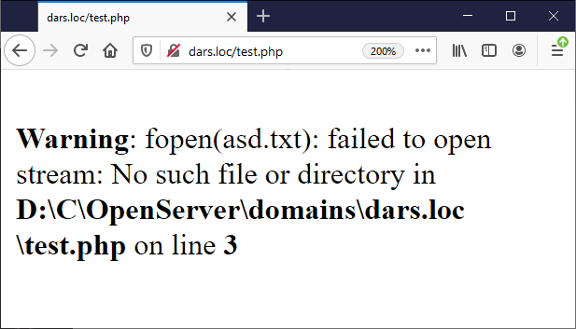
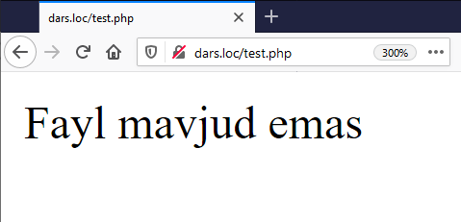
Xatolarni "tekshirish"
<?php
$file = "asd.txt";
fopen($file, 'r');
if (file_exists($file)) {
fopen($file, 'r');
} else {
// Xato bo'lgandagi qayta ishlash
echo "Fayl mavjud emas";
}

Slide 9
Xatolarni tutib olish (istisnolar)
throw – istisnoni ishga tushurish
try – xatoni tutib olish mumkin bo'lgan kod qismini ishlatishga harakat qilish
catch – istisnoni ishlatish
finally – try/catch blokidan keyin doim ishga tushadigan kod qismi

Slide 10
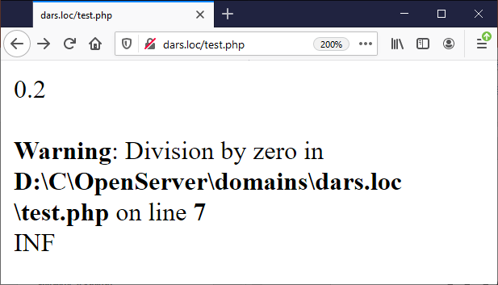
try/catch
<?php
function inverse($x)
{
return 1 / $x;
}
echo inverse(5) . "\n<br>";
echo inverse(0) . "\n<br>";

Slide 11
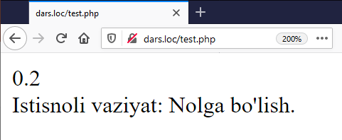
try/catch
<?php
function inverse($x)
{
if (!$x) {
throw new Exception("Nolga bo'lish.");
}
return 1 / $x;
}
try {
echo inverse(5) . "\n<br>";
echo inverse(0) . "\n<br>";
} catch (Exception $e) {
echo 'Istisnoli vaziyat: ', $e->getMessage(), "\n";
}

Slide 12
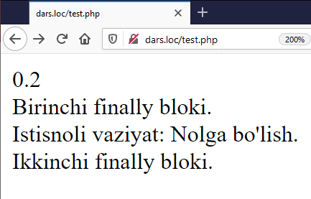
try/catch
try {
echo inverse(5) . "\n<br>";
} catch (Exception $e) {
echo 'Istisnoli vaziyat: ', $e->getMessage(), "\n<br>";
} finally {
echo "Birinchi finally bloki.\n<br>";
}
try {
echo inverse(0) . "\n<br>";
} catch (Exception $e) {
echo 'Istisnoli vaziyat: ', $e->getMessage(), "\n<br>";
} finally {
echo "Ikkinchi finally bloki.\n<br>";
}

Slide 13
Xatolar va istisnolar turlari
Error ArithmeticError DivisionByZeroError AssertionError ParseError TypeError ArgumentCountError Exception ClosedGeneratorException DOMException ErrorException IntlException LogicException BadFunctionCallException BadMethodCallException DomainException InvalidArgumentException LengthException OutOfRangeException PharException ReflectionException RuntimeException OutOfBoundsException OverflowException PDOException RangeException UnderflowException UnexpectedValueException SodiumException
https://www.php.net/manual/en/reserved.exceptions.php
https://www.php.net/manual/en/spl.exceptions.php

Slide 14
Istisnolarni yaratish
Exception – foydalanuvchi istisnolari uchun asosiy bazaviy sinf:
Exception::__construct — istisnoni yaratish
Exception::getMessage — istisno xabarini olish
Exception::getPrevious — oldingi istisnoni qaytarish
Exception::getCode — istisno kodini olish
Exception::getFile — istisno yuzaga kelgan faylni olish
Exception::getLine — istisno yuzaga kelgan qatorni olish
Exception::getTrace — stek trassirovkasini (yo'lini) olish
Exception::getTraceAsString — stek trassirovkasini (yo'lini) satr ko'rinishida olish
Exception::__toString — istisnoning satrli ko'rinishi
Exception::__clone — istisnoni nusxalash
https://www.php.net/manual/en/language.exceptions.extending.php

Slide 15
Logging (Xatolar jurnali)
Nima uchun kerak?
xatolarni topish oson;
ko'proq ma'lumotlar;
kod uchun "iz";
qayerda xohlasa o'sha yerda "yozish".
Apachening error_log fayli orqali ham xatolar jurnalini server darajasida yurg'azish mumkin, faqat:
error_log juda oddiy;
o'qish / tahlil qilish murakkab;
"error_reporting" sozlamasiga bog'liq.

Slide 16
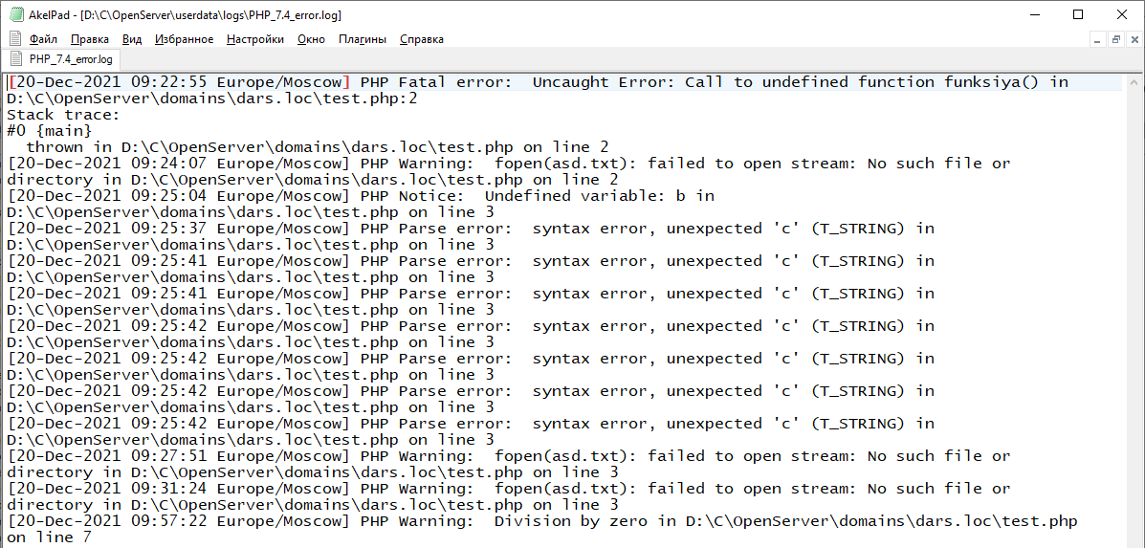
Apache xatolar jurnali

Slide 17
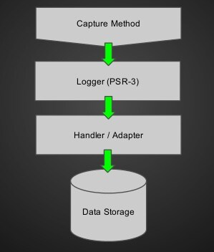
Logging uchun
Monolog
Phpconsole
Log4php
RavenPHP + Sentry
SeasLog
Standart: PSR-3 – PHP Standart Recommendation 3
https://www.php-fig.org/psr/psr-3/

Slide 18
Log yozuvchi sinf namunasi
<?php
final class Logger
{
private array $lines;
private string $file;
public int $time;
public function __construct(string $filelog, int $time = null, bool $save = true)
{
$this->file = $filelog;
$this->time = $time ?? time();
if ($save) {
register_shutdown_function([$this, 'save']);
}
}

Slide 19
Log yozuvchi sinf namunasi
public function set(...$val): \Logger
{
if (func_num_args() > 1) {
$this->lines[] = sprintf(...$val);
return $this;
}
$this->lines[] = $val[0];
return $this;
}
public function save(): void
{
if (!empty($this->lines)) {
$start = date('Y-m-d H:i:s - ', $this->time);
file_put_contents($this->file, $start . implode(PHP_EOL . $start, $this->lines) . PHP_EOL, FILE_APPEND);
$this->lines = [];
}
}
}

Slide 20
Log yozuvchi sinf namunasi
<?php
$file_log = __DIR__ . '/file.log';
$logger = new Logger($file_log);
$logger->set('Hello');
$logger->set('Hi');
$logger->set($file_log);
$logger->set('afk');
Faylda:
2021-03-03 23:34:02 - Hello
2021-03-03 23:34:02 - Hi
2021-03-03 23:34:02 - .../file.log
2021-03-03 23:34:02 - afk

Slide 21
Savollar?

